Slide 1
Basic Drawing Shapes

Slide 2
Drawing Lines
Pygame allows you to draw lines from a staring point to and endpoint on a screen
The general syntax is:
  pygame.draw.line(screen, color, (x1, y1), (x2, y2), thickness)
  color is the color of the line used
  (x1, y1) is one endpoint of the line
  (x2, y2) is the other endpoint of the line
  thickness is how many pixels thick your line is.
    Note: pygame isn’t perfect. Thick lines may have some drawing glitches.

Slide 3
Drawing Lines Example
Let screen be a newly created screen that has a width of 640 and a height of 500
Write the commands to draw a thin red line from the top-left corner to the bottom-right corner and a thick green line from the bottom-left corner to the top-right corner

Slide 4
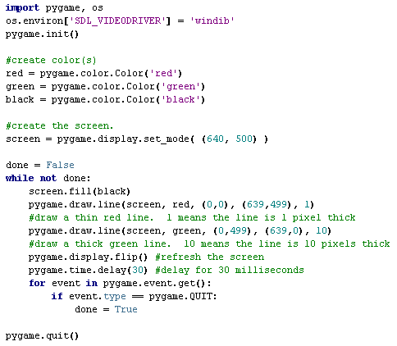
Drawing Lines Code Example

Slide 5
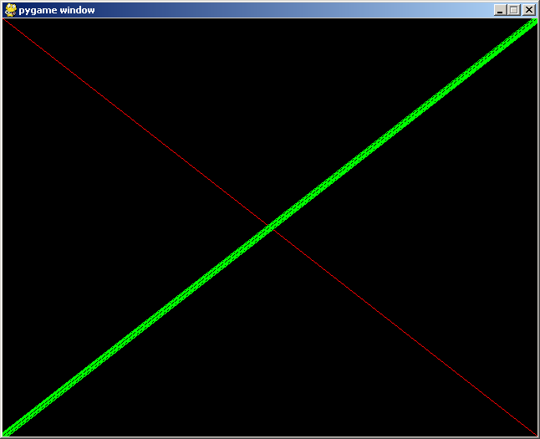

Slide 6
Drawing Shapes
Drawing shapes requires that you specify the following:
  The screen you want to draw on
  The color you want your drawing to be
  The top-left corner of the shape (x,y)‏
  the width of the shape (w)‏
  the height of the shape (h)‏
  The thickness of the line used to draw your shape
    Important! Python interprets a thickness of 0 to mean your shape is filled-in

Slide 7
List of possible commands:
python.draw.rect(screen, color, (x, y, w, h), thickness)
  Draw a rectangle on the screen.
python.draw.ellipse(screen, color, (x, y, w, h), thickness)
  Draw an oval or a circle on the screen.
screen is the screen you will be drawing on
color is the color your shape will be
x – the x-coordinate of the top-left corner of your shape
y – the y-coordinate of the top-left corner of your shape
w – the width of your shape
h – the height of your shape
thickness – how thick the line used to draw your shape is
  Remember! A thickness of 0 means your shape is filled in

Slide 8
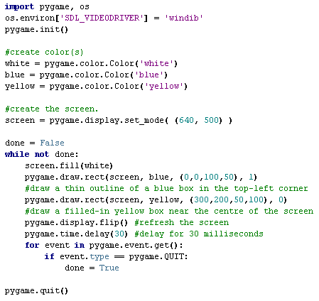
Example 1 – Drawing Rectangles

Slide 9
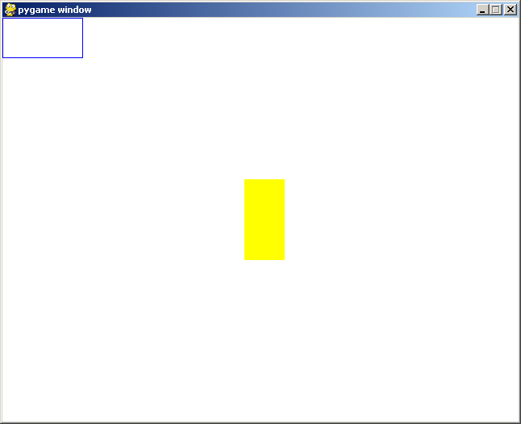
Example 1 - Output

Slide 10
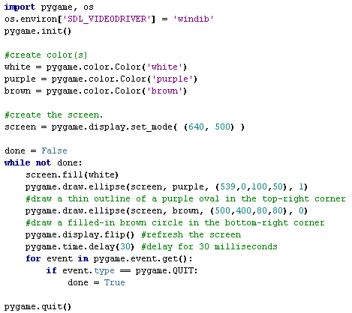
Example 2 – Drawing Ovals

Slide 11
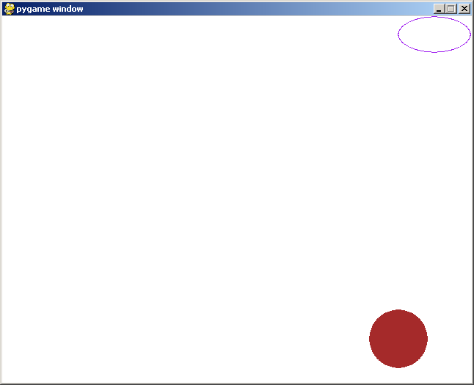
Example 2 - Output

